Slide 1

Section 3.5 Implicit Differentiation
Lecture 1
It's just the chain rule

Slide 2

Homework Submission to Canvas
Preview of section
Skim the section in text and write a short paragraph summary.
Give a bulleted list of all important definitions, theorems, and formulas without details.
Notes on video lectures
Take notes on everything written on slides including all details, worked examples, on-own activities, as well as your own thoughts and questions.
Try on-own activities first, then write down provided solution next to it for comparison.
Worked examples from the text
Write down the problem and attempt without looking at the solution.
Use the solution to write the best explanation you can.
Solutions to textbook exercises
Model approaches and explanations given in the video lectures and textbook examples.
Final reflection of section
List the key takeaways to remember as a bulleted list.
Video reflection (for some sections)
Write a 1 paragraph reflection on the video discussing what you found most interesting or useful.

Slide 3
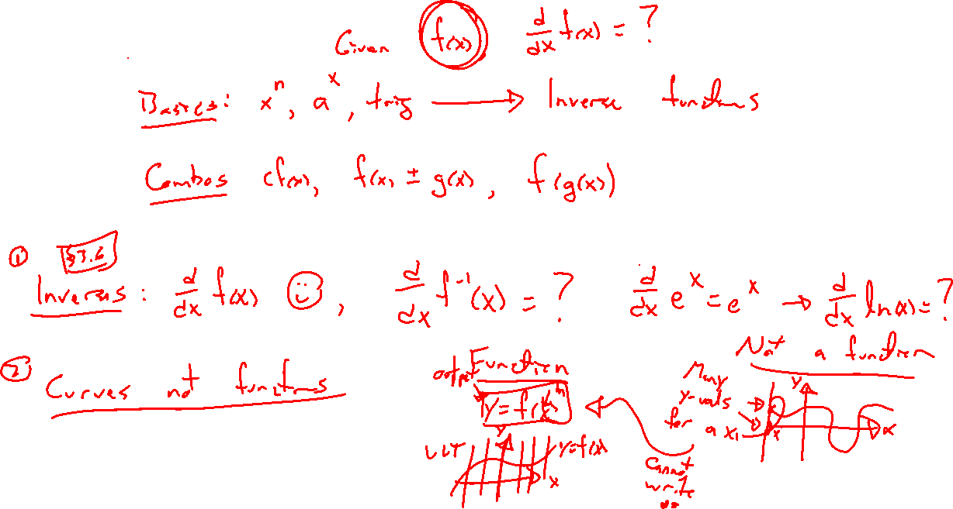
What remains?
Notes:
We apply the chain rule to stretch our capabilities:
- Inverse functions (log for exp, inv trig, others), next section
- Curves which are not functions (circle, others), this section

Slide 4
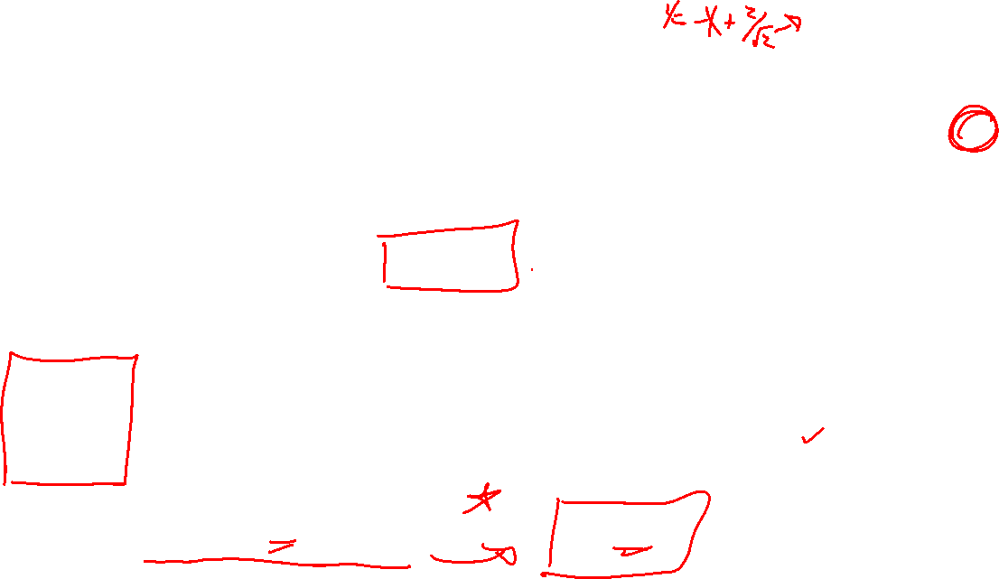
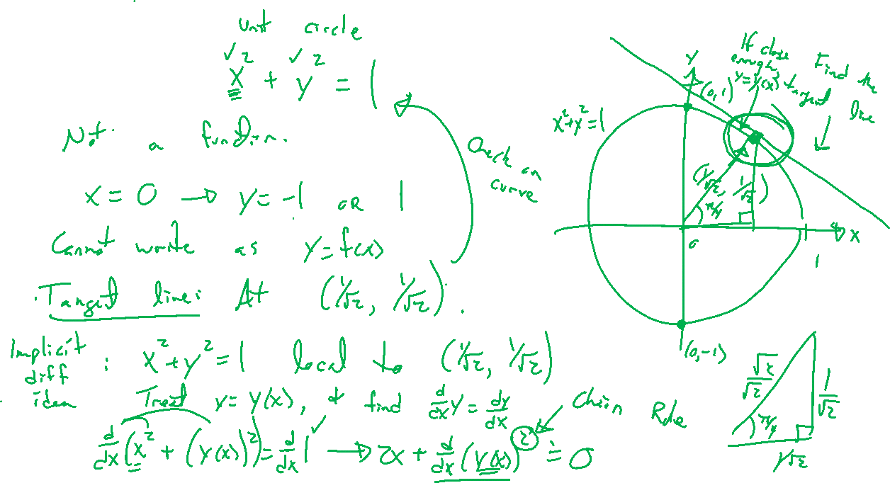
Example:
Notes:
Find the equation of the tangent line to x^2+y^2=1 at point (1/\sqrt{2}, 1/\sqrt{2}).
- check that point is actually on the curve. Need dy/dx at this point then done.
- assume y = y(x) locally to this point, apply chain rule
- note, could have solved for y first in this case, try on own.

Slide 5
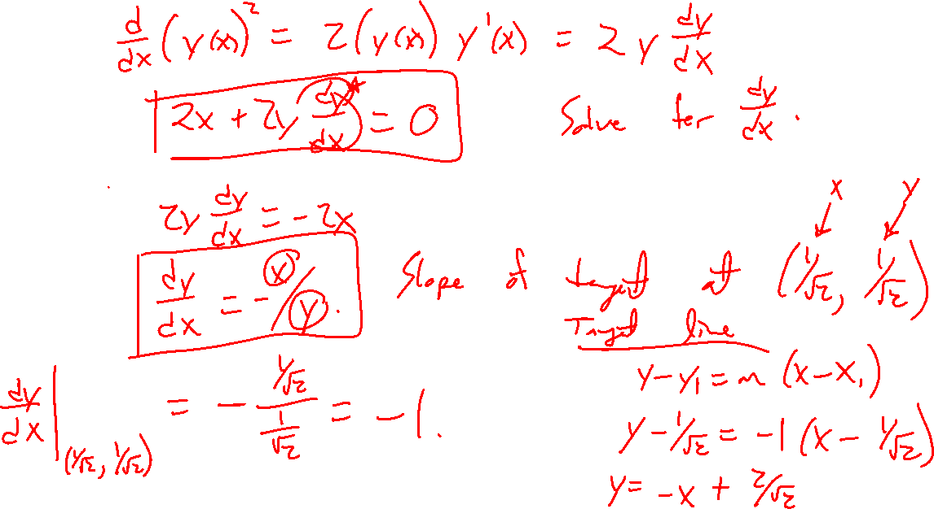

Slide 6
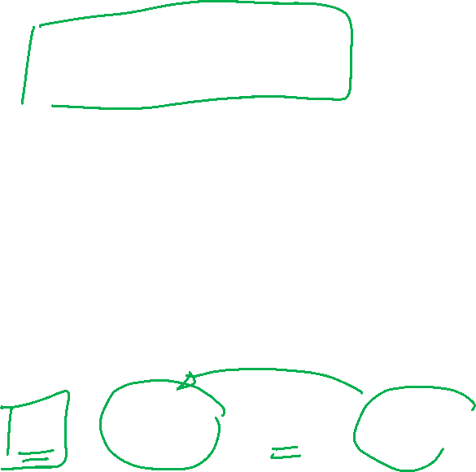
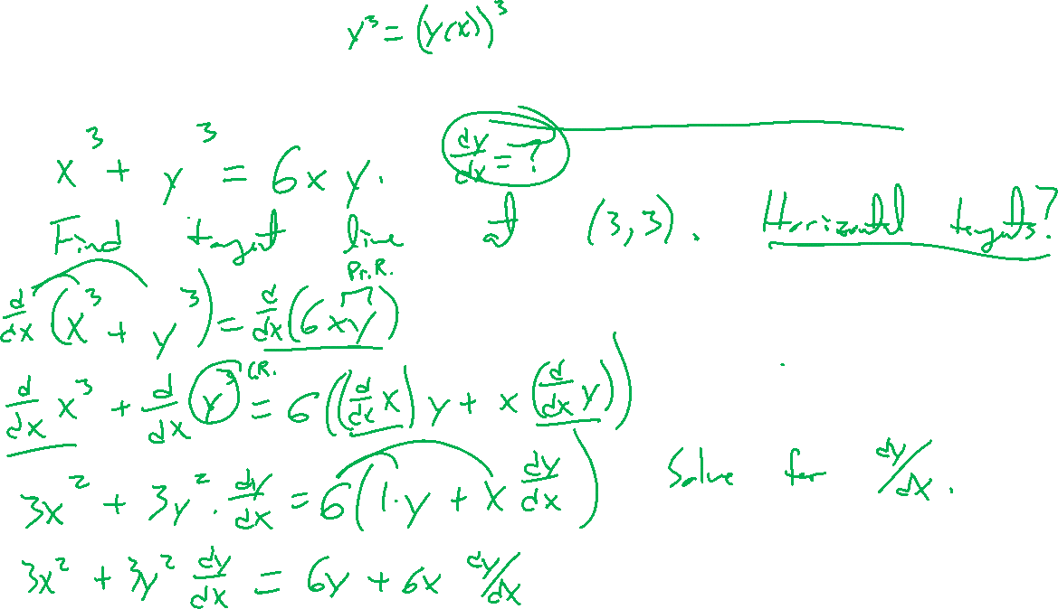
Example: Try on own, Folium of Descartes
Notes:
X^3+y^3=6xy
Wiki page story
Find tangent line at (3,3). Horizontal tangents?

Slide 7
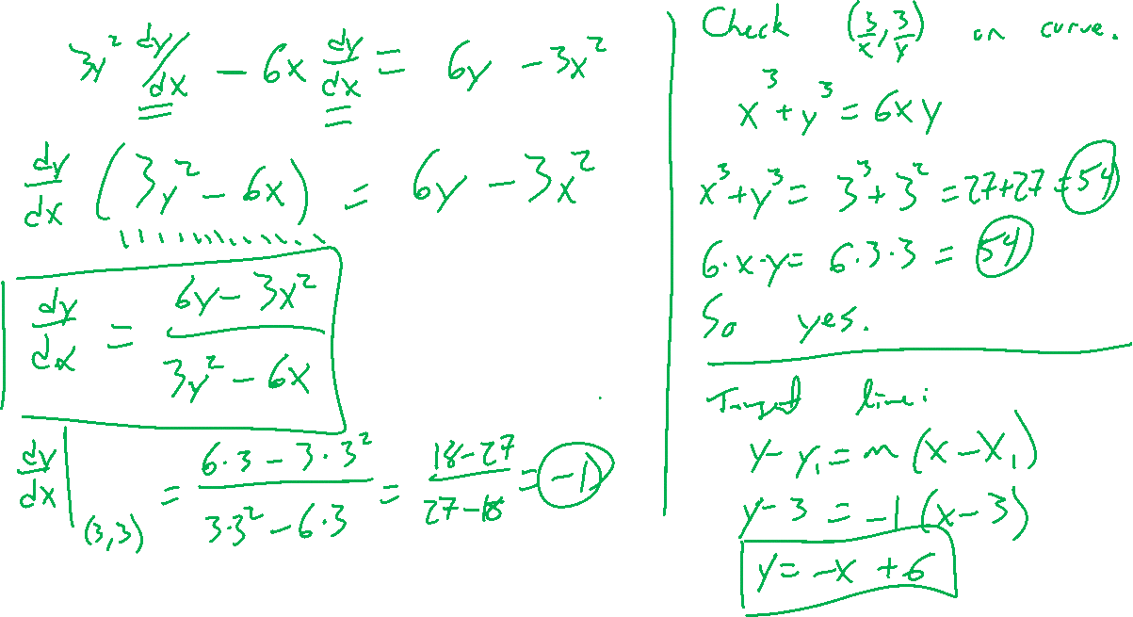


Slide 8
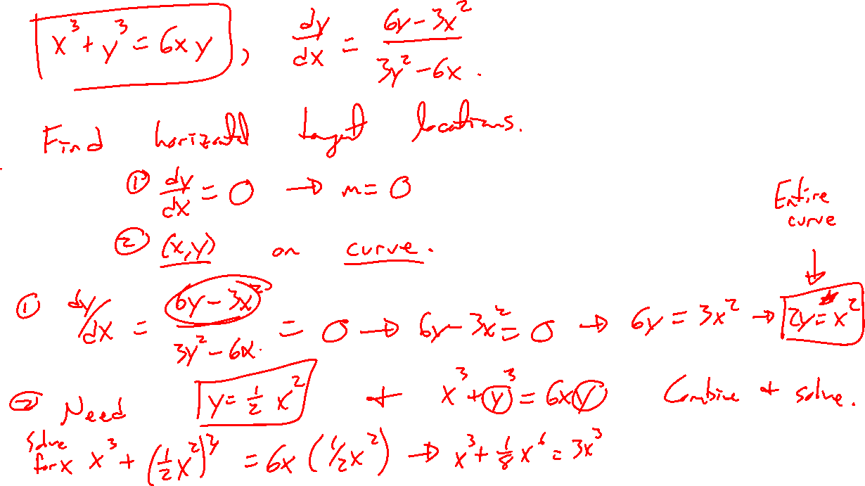


Slide 9
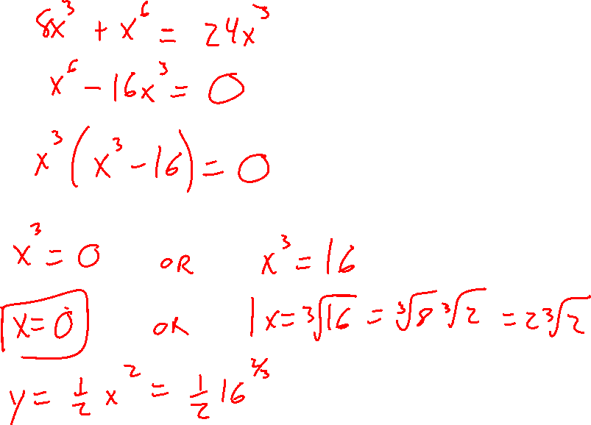

Slide 10
Theorem: More power rule
Notes:
Can extend the power rule to rational exponents.
Y = x^p/q gives y^q = x^p, diff both sides and solve.
What about irrational powers?

